Slide 1















Security Enhancement Of Openflow Networks
By
Eng. Khaled Elsayed Ahmed
Supervised by Prof. Dr. Ihab Abdelwahab Ali

Slide 2
Project vision and mission
Proactive Detection and Prevention
To develop and implement advanced, real-time monitoring and detection mechanisms within SDN networks that can identify and mitigate potential DoS attacks before they can impact network performance and security.
01.
To conduct cutting-edge research into new methodologies and technologies for securing SDN networks, ensuring that our solutions evolve with the changing landscape of cyber threats and remain at the forefront of DoS defense strategies.
02.
To develop and implement advanced security protocols and mechanisms within SDN architectures that proactively detect, prevent, and respond to DoS attacks. Our mission is to enhance the robustness and reliability of SDN networks through continuous research, innovation, and collaboration with industry leaders, fostering a safer digital esystem.
To foster partnerships with academic institutions, industry leaders, and cybersecurity experts to share knowledge, develop best practices, and educate network administrators on the latest security protocols and techniques to protect SDN networks from DoS attacks.
03.

Slide 3





PHASE 1
SECURITY ENHANCEMENT OF OPENFLOW NETWORKS
phase 1
Implementation of SDN topology
phase 2
Adding services to Network
phase 3
DOS Attack simulation and Detection
phase 4
Mitigation from DOS attack

Slide 4
IMPLEMENTATION
PHASE 1
A DEEP UNDERSTANDING OF SDN NETWORKS AND THEIR IMPLEMENTATION

Slide 5
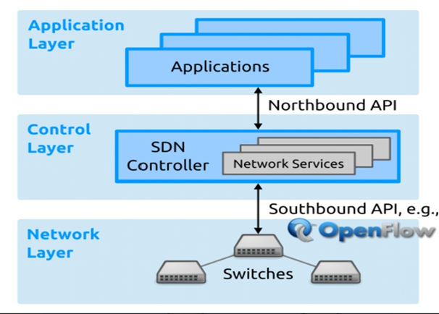
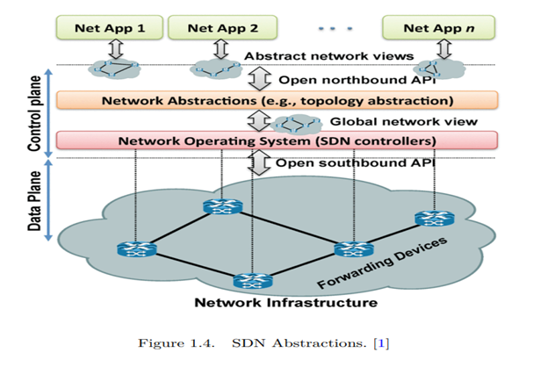
SDN
IMPLEMENTATION
1)SDN Definition.
2)SDN Architecture.
3)SDN benefits.

Slide 6

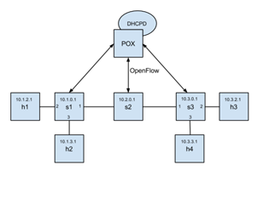
IMPLEMENTATION
SDN Architecture
1)NFV (NETWORK FUNCTIONS VIRTUALIZATION)
2)HOW OPENFLOW HELPS IN SDN NETWORKS:
3)WHAT IS OPEN VSWITCH?

Slide 7


IMPLEMENTATION
Mininet&pox
Implementation with Mininet and POX Controller
Why we use Pox controller ?
1)Flexibility and Customizability
2)Active Community and Documentation
3)Support for SDN Concepts

Slide 8
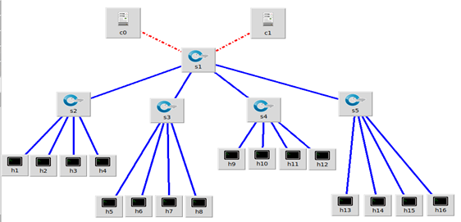
IMPLEMENTATION
Mininet&pox
Setting the Stage for SDN Exploration
1)Installing ubuntu
2)Installing Mininet and pox controller
$. /pox.py openflow. of_01 --port=6100 forwarding. l2_pairs
$. /pox.py openflow. of_01 --port=6101 forwarding. l2_pairs
$sudo mn --switch ovsk --topo tree,depth=2,fanout=4--
controller=remote,ip=127.0.0.1,port=6100
,

Slide 9
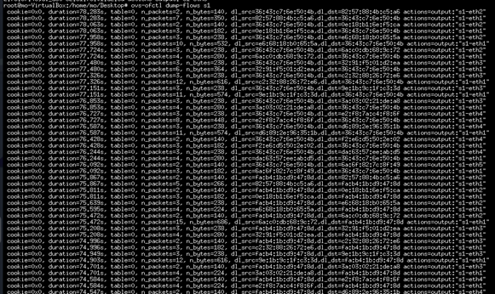
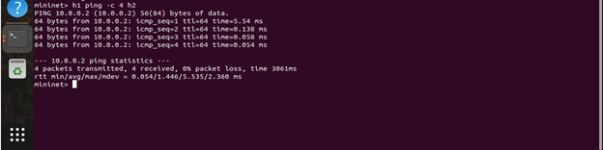
IMPLEMENTATION
Testing Network Connectivity
1)A ping from h1 to h2 (send 4 packets)
2)S1 flow rules after pingall and there are more flow rules.

Slide 10
SERVICES
PHASE 2
ENHANCEMENT OF SDN COMMUNICATION SERVICES BY APPLYING DIFFERENT STRATEGIES

Slide 11
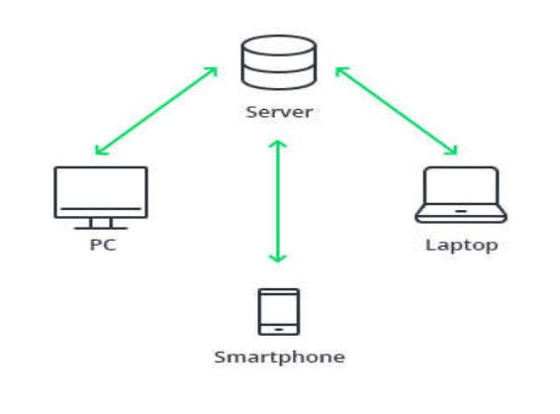

SERVICES
SERVER TO CLIENT COMMUNICATION
WING FTP SERVER ADMIN
IT IS A SOFTWARE SOLUTION USED FOR TRANSFERRING FILES ACROSS THE INTERNET USING FTP PROTOCOL.
THIS SERVER CAN DO MULTIPLE THINGS LIKE
FILE ACCESS
SERVER LOGS
AUDIT & REPORT
GRAPHS & ACTIVITY

Slide 12
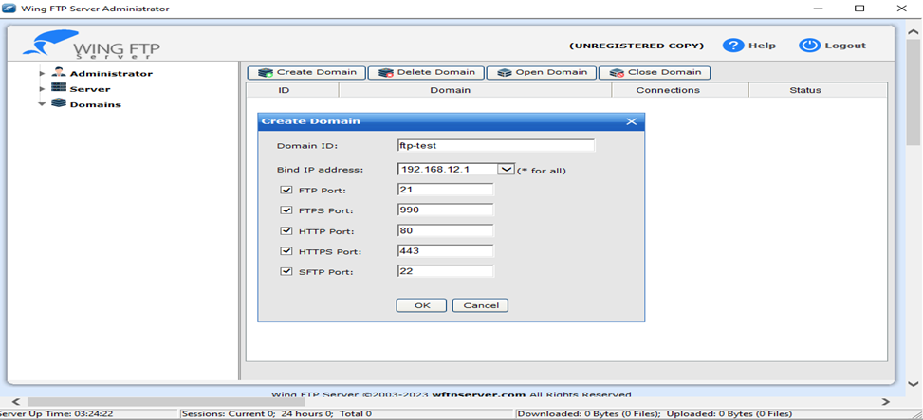
SERVICES
CONFIGURATION OF THE SERVER
CREATION OF THE FTP SERVER

Slide 13
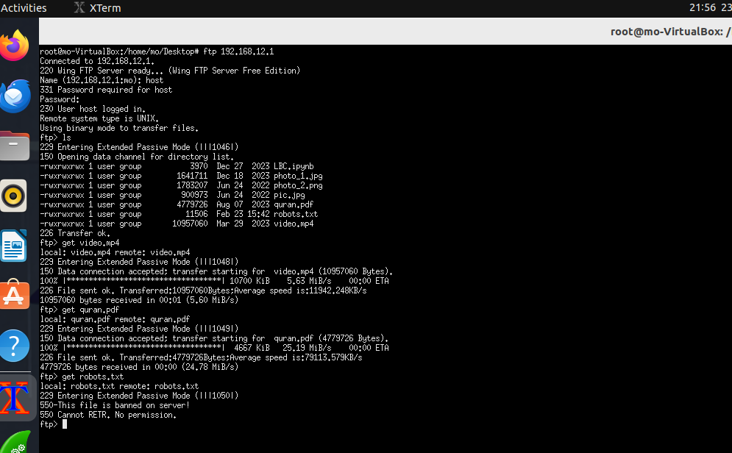
SERVICES
ON SDN NETWORK
FROM THE CLI OF H1.
CONNECT TO THE SERVER BY IP ADDRESS.
ENTER THE CREDENTIALS (USERNAME,PASSWORD).
LS COMMAND TO SEE THE FILES ON THE SERVER.
GET (DOWNLOAD)SOME FILES FROM THE SERVER.
TRY TO DOWNLOAD THE BANNED FILE.

Slide 14
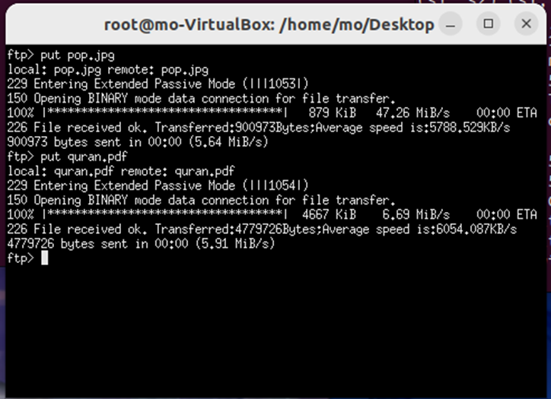
SERVICES
ON SDN NETWORK
ALSO IF WE WANT TO UPLOAD SOME FILES TO THE SERVER.

Slide 15
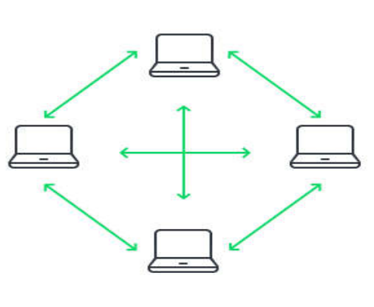
SERVICES
PEER TO PEER COMMUNICATION
BOTH PEERS EXCHANGE INFORMATION WITH EACH OTHER WITHOUT THE NEED FOR ANY INTERMEDIATE SERVERS.
NC IS A POWERFUL AND VERSATILE NETWORKING UTILITY TOOL USED FOR READING FROM AND WRITING TO NETWORK CONNECTIONS.
IT PROVIDES A SIMPLE AND STRAIGHTFORWARD WAY TO CREATE TCP/IP CONNECTIONS, LISTEN FOR INCOMING CONNECTIONS, TRANSFER DATA, AND PERFORM VARIOUS NETWORK-RELATED TASKS.

Slide 16
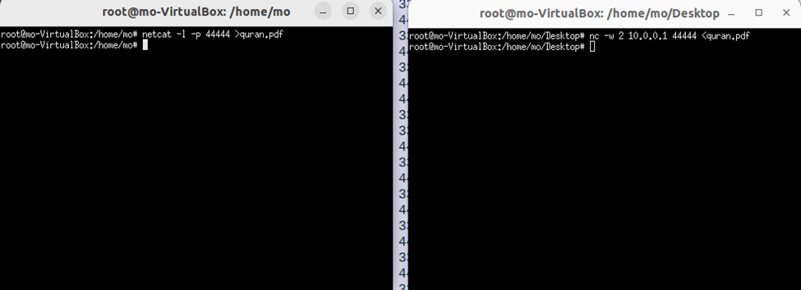
SERVICES
NETCAT
H1 IS LISTENING FOR AN INCOMING CONNECTION
H16 SENDS THE FILE

Slide 17
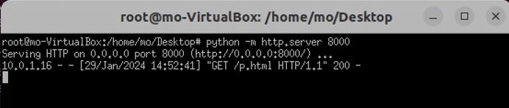
SERVICES
WEB SERVICE
IMPLEMENTATION OF HTTP SERVER
THE HOST CAN SERVE WEB CONTENT AND RESPOND TO HTTP REQUESTS FROM OTHER HOSTS IN THE NETWORK.

Slide 18
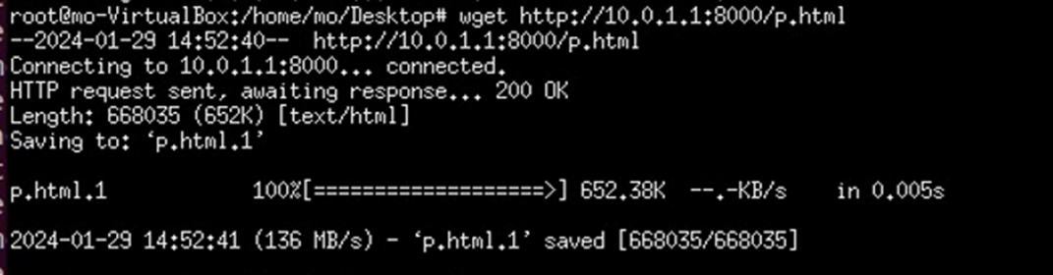
SERVICES
WEB SERVICE
ACCESS THE HTTP SERVER FROM ANOTHER HOST
LET’S BREAKDOWN THE COMMAND
Wget http://10.0.1.1:8000/p.html

Slide 19
SERVICES
TRACEROUTE
INSTALLATION OF TRACEROUTE

Slide 20
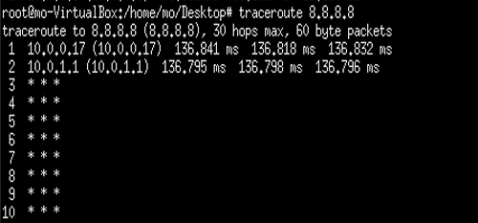
SERVICES
TRACEROUTE
PROBLEM FACED

Slide 21
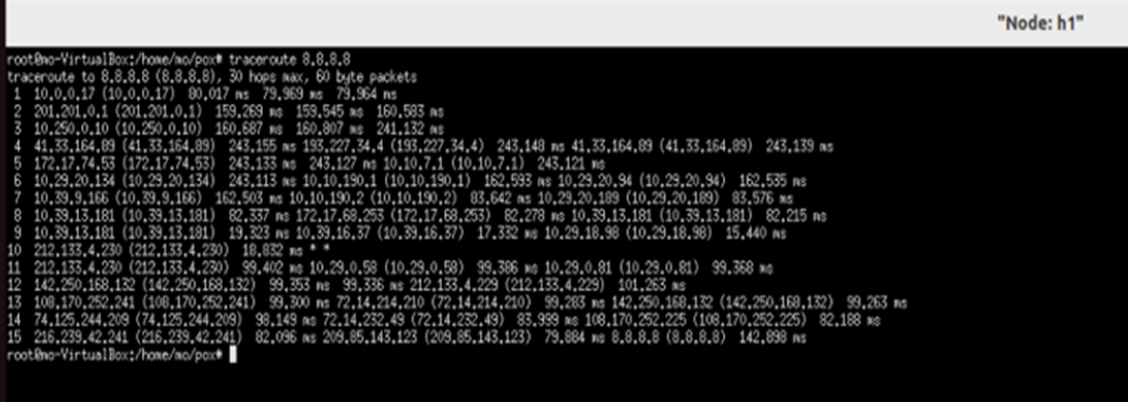
SERVICES
TRACEROUTE
HOW WE SOLVE THE PROBLEM ?

Slide 22
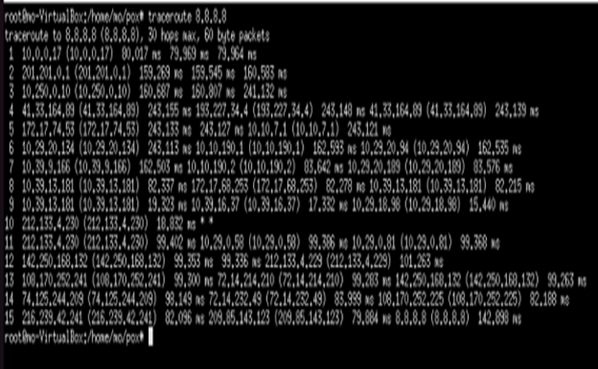
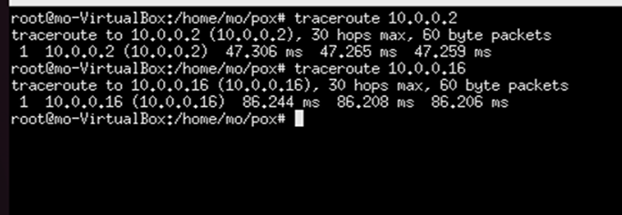
SERVICES
TRACEROUTE
TOOL USAGE

Slide 23
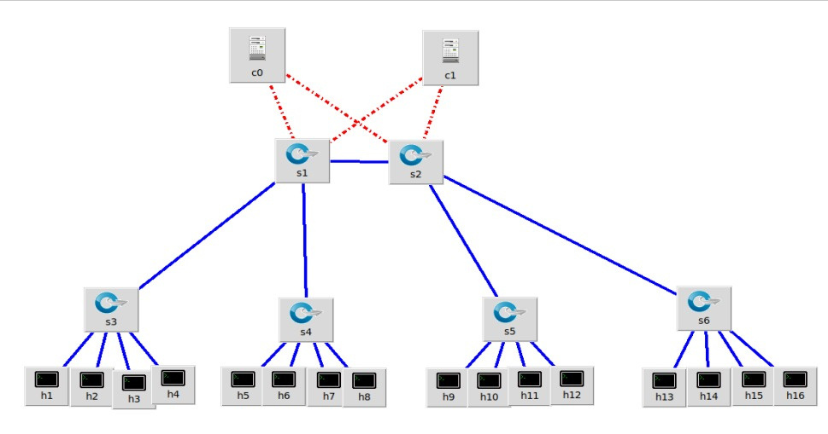
SERVICES
THE LAST UPDATED TOPOLOGY WITH PYTHON SCRIPT

Slide 24
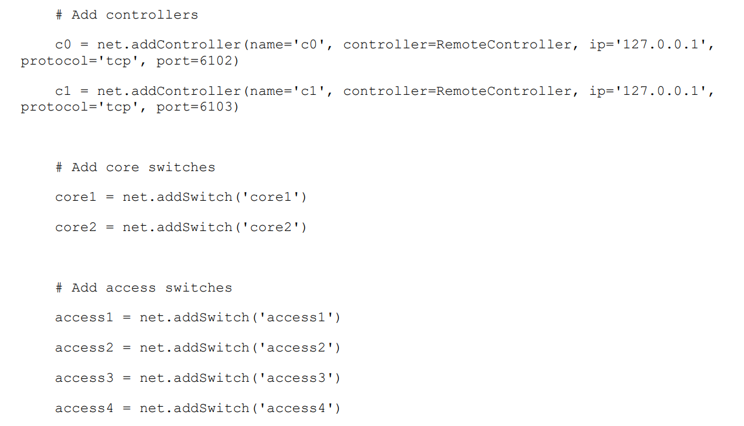
SERVICES
THE PYTHON SCRIPT THAT USED TO CREATE THE TOPOLOGY

Slide 25
DOS ATTACK SCENARIO
PHASE 3
DOS ATTACK AND DETECTION

Slide 26
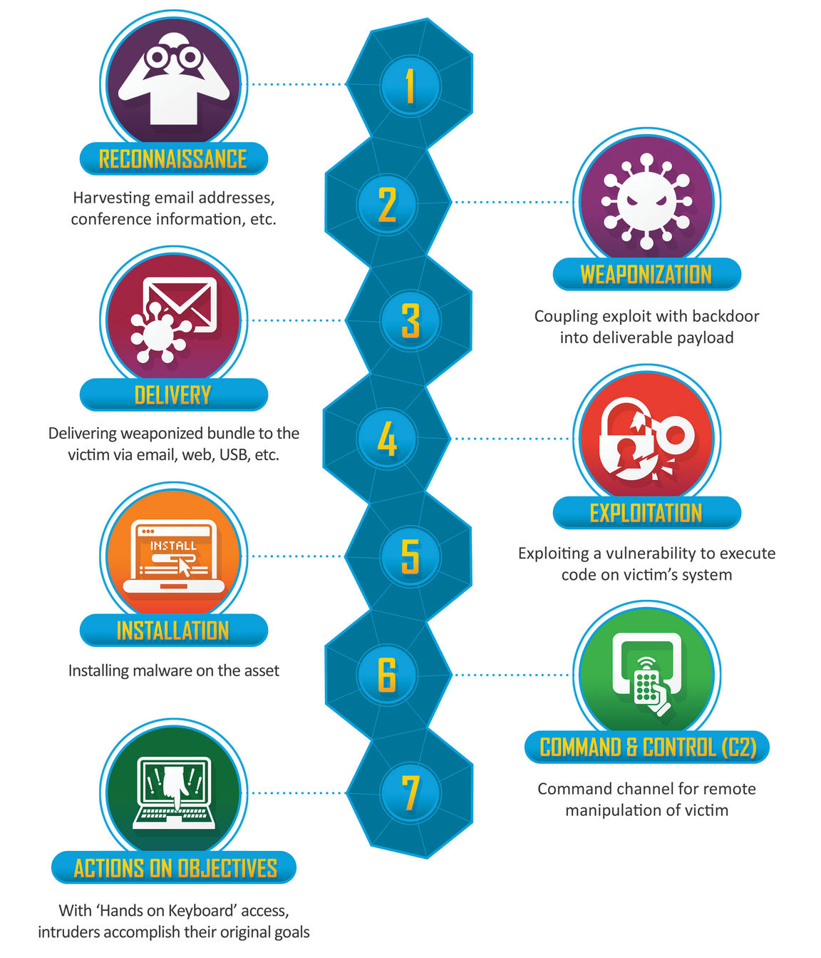
DOS ATTACK SCENARIO
THE CYBER KILL CHAIN MODEL
Developed by Lockheed Martin
It is part of the Intelligence Driven Defense model for identification and prevention of cyber intrusions activity.
The model identifies what the adversaries must complete in order to achieve their objective.
The seven steps of the Cyber Kill Chain enhance visibility into an attack and enrich an analyst’s understanding of an adversary’s tactics, techniques and procedures.

Slide 27


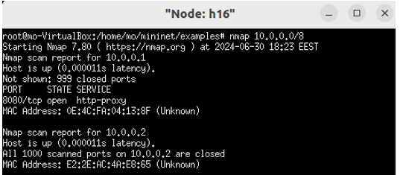
DOS ATTACK SCENARIO
RECONNAISSANCE
Goal: Gather information about the target.
Action: Perform network scanning to identify open ports and services running on h1 (HTTP server).
Details: Using nmap on h1 to discover open port 8080, which indicates the HTTP server is running.
1-ARP Packets:h16 will need to resolve the IP addresses of other hosts (like h1) to their MAC addresses. This triggers ARP requests and replies.
2-TCP Packets:h16 sends TCP/IP packets to the specified IP range and listens for responses to determine which hosts are active and which ports are open

Slide 28


DOS ATTACK SCENARIO
WEAPONIZATION
Goal: Create a deliverable payload for the attack.
Action: Prepare the DoS attack payload using hping3.
Command: $ hping3 -d 300 -S -w 64 -p 8080 --flood --rand-source -V 10.0.0.1
1-Payload: Overwhelms h1 by sending a high volume of SYN packets to port 8080.
2-Flood Mode: Maximizes impact by sending packets rapidly.
3-Random Source IPs: Evades detection and filtering by the target.
4-Data Size: Each packet includes 300 bytes of data, adding to the target's load.
5-Verbose Output: Offers detailed feedback for monitoring and analysis.

Slide 29
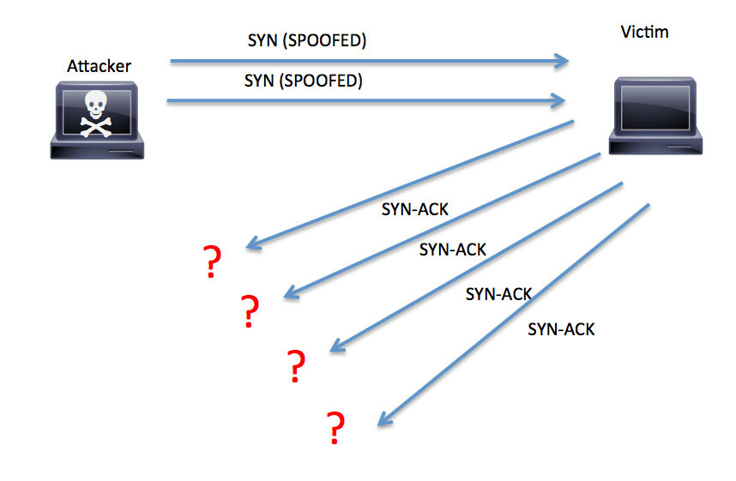

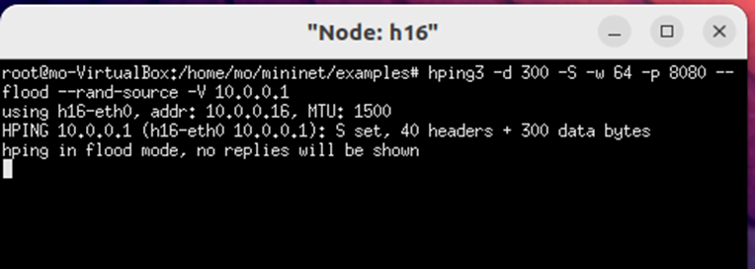
DOS ATTACK SCENARIO
DELIVERY
Goal: Deliver the weapon to the target environment.
Action: Initiate the DoS attack from h16.
Details: Use hping3 to send a high volume of TCP packets to port 8080 on h1.
When running the command of the attack on h16 ,the server flooded with tcp packets from random ip addresses.

Slide 30

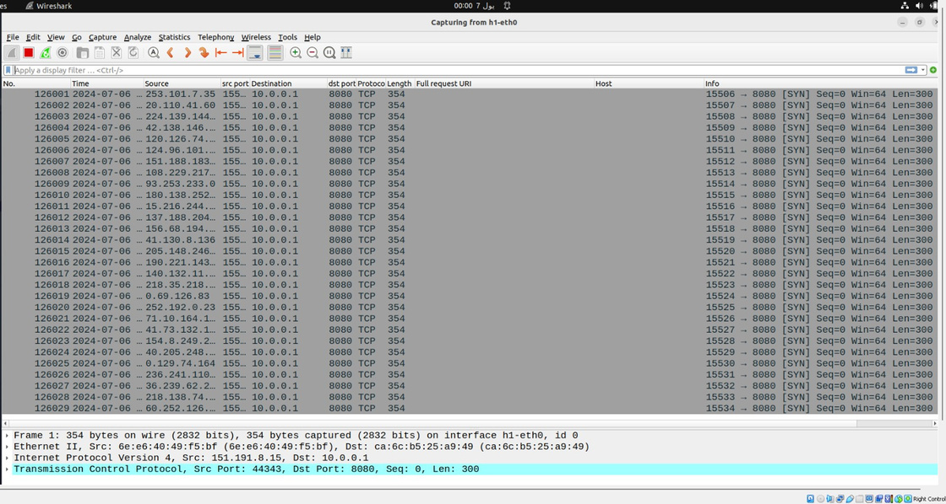

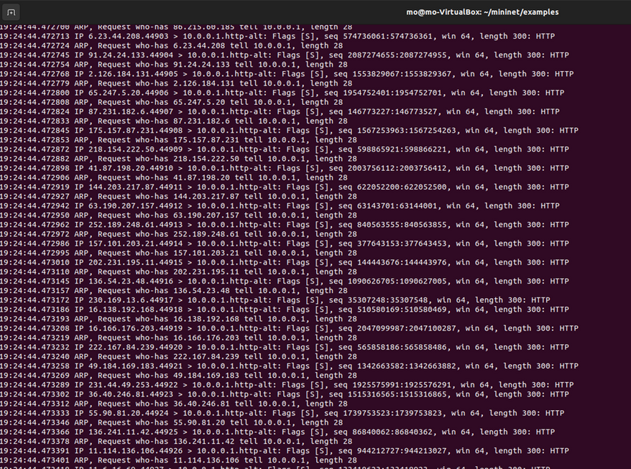

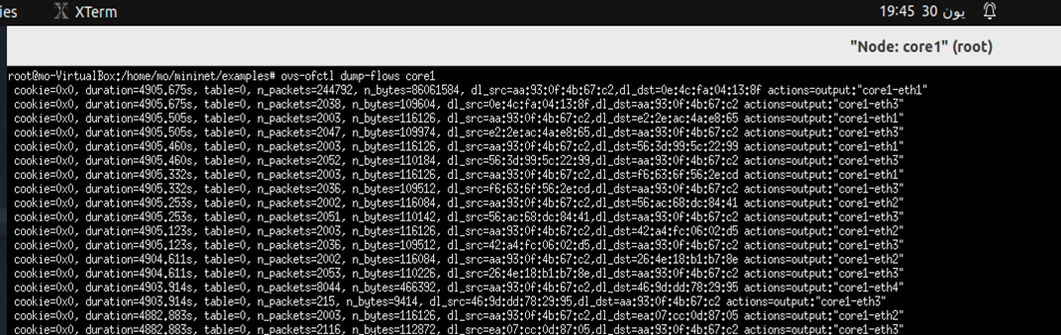
DETECTION AND CAPTURE OF THE ATTACK
Wireshark
TCPDUMP
FlowRules

Slide 31

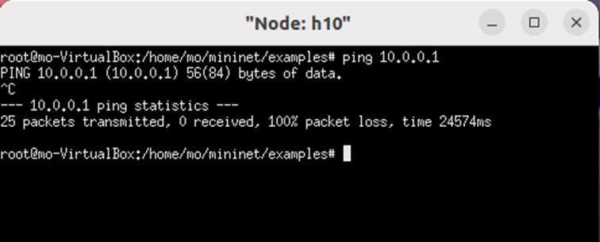
DOS ATTACK SCENARIO
EXPLOITATION
VERIFICATION
Goal: Trigger the payload on the target system.
Action: Exploit the target by overwhelming its resources.
Details: The high volume of TCP packets causes h1 to become unresponsive.
Impact:
1.Wireshark: Capture and analyze the flood of SYN packets and the lack of responses from h1 as before.
2.Ping Test: Observe timeouts when pinging h1 from another host (h10), confirming the DoS impact.
1.Resource Exhaustion: CPU, memory, and network bandwidth on h1 are consumed by the attack, causing a denial of service.
2.Service Unavailability: The HTTP server on h1 becomes unresponsive to legitimate requests.
All packets are lost this mean that the impact of the attack is obvious where h10 does not receive any replay from h1 because of the attack on it.

Slide 32


DOS ATTACK SCENARIO
INSTALLATION
COMMAND AND CONTROL (C2)
Goal: Install a backdoor or other persistent access mechanism.
Goal: Establish command and control channels to communicate with the compromised system.
For a DoS attack, this stage does not apply since the goal is disruption rather than persistent access.
For a DoS attack, this stage may not apply as there is no need for a C2 channel in a simple DoS scenario.

Slide 33

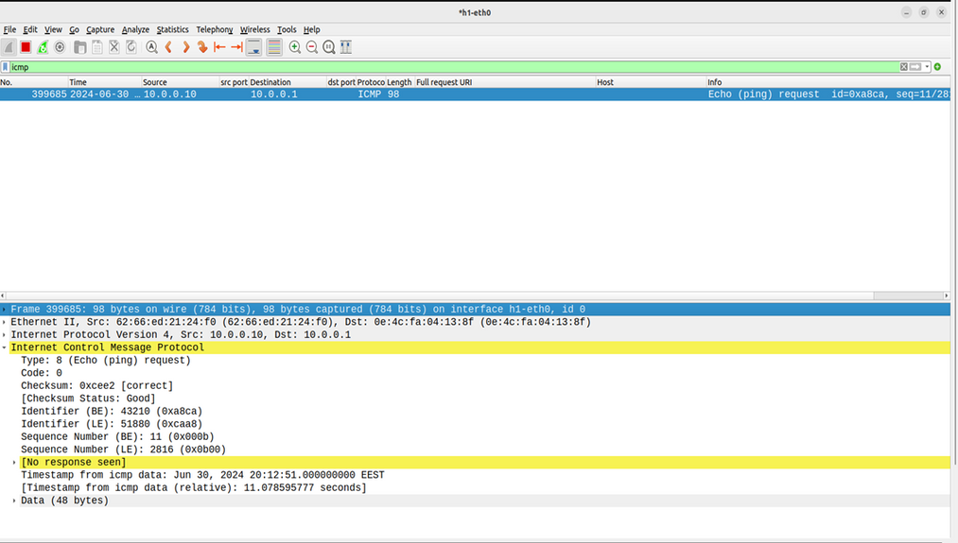
DOS ATTACK SCENARIO
ACTIONS ON OBJECTIVES
Goal: Achieve the attacker’s goals. which is Disrupt the availability of the HTTP server by overwhelming it with requests, making it unable to respond to legitimate traffic.
Action: Disrupt service on h1(http server).
Details: Monitor the effectiveness of the DoS attack by pinging h1 from h10 to verify that packets are dropped as we see before

Slide 34
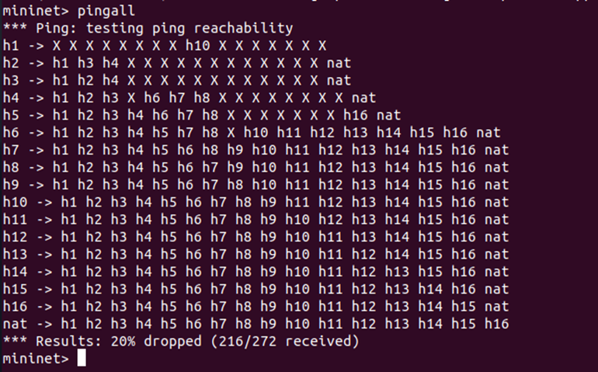
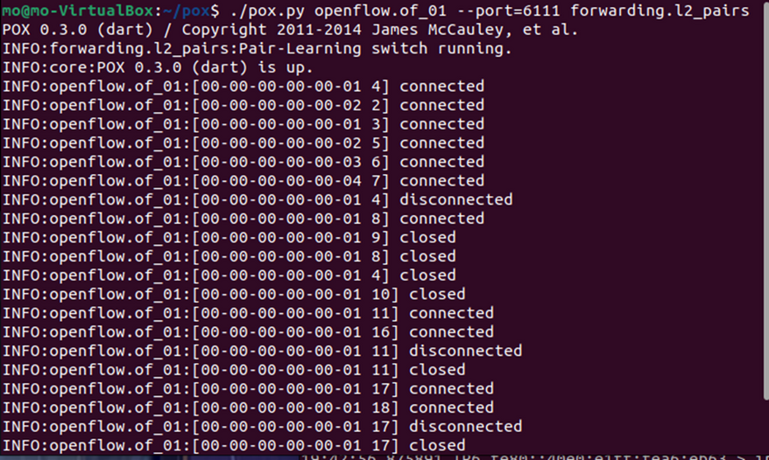
SOME NOTES WHEN APPLYING THE KILL CHAIN MODEL IN THE SDN NETWORK USING DOS
During Attack:
Multiple OpenvSwitches go down due to resource exhaustion.
Network segments connected through these switches become temporarily disconnected.
Post-Attack:
The switches recover and re-establish connections.
Network functionality is restored without manual intervention.

Slide 35
MITIGATION
PHASE 4
MITIGATION FROM DOS ATTACK

Slide 36
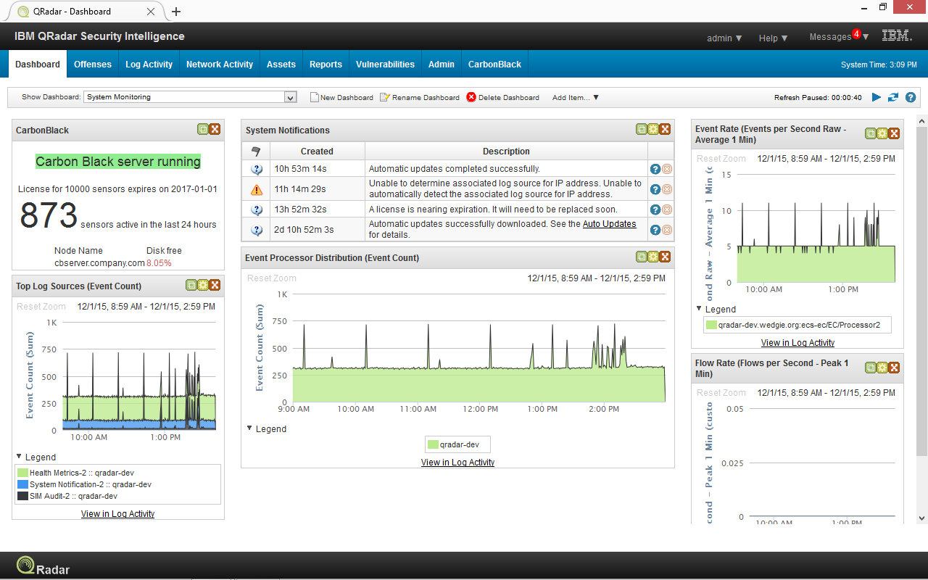
MITIGATION
PRACTICAL DETECTION
siem solution.
eg:
IBM Qradar
Splunk

Slide 37
PROBLEM OVERVIEW
Wireshark
TCPDUMP
FlowRules

Slide 38
MITIGATION
PROBLEM OVERVIEW
Crucial effect of DOS attack on enterprises.
availability concept
financial issues
Negative media attention
launching other attacks

Slide 39
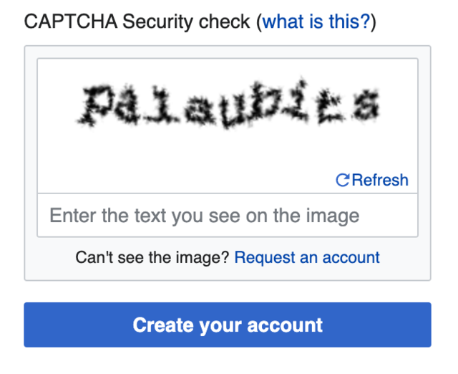
MITIGATION
TRADITIONAL MITIGATION TECHNIQUES
limitations of traditional DoS mitigation techniques .
e.g:
static filtering
resource limitations
Challenge-Response Systems (solving a captcha)

Slide 40
MITIGATION
MITIGATION PRINCIPLES
implementing a python script based on :
rate limiting ( with defining a threeshold )
subnet checking

Slide 41
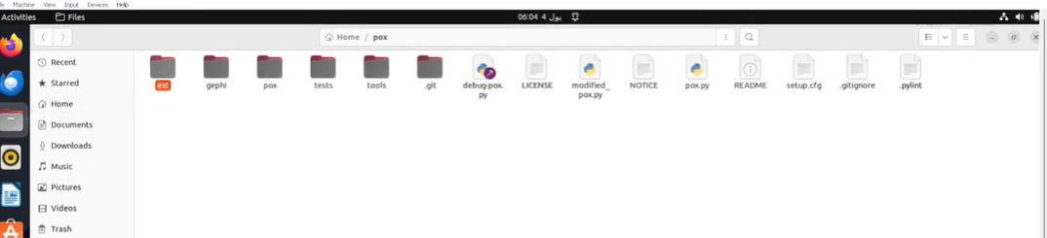
MITIGATION
MITIGATION
planting the python script inside pox , ext directory

Slide 42
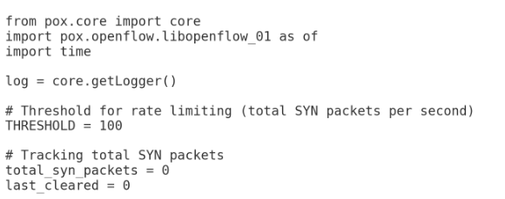
MITIGATION
SCRIPT OVERVIEW
Imports and Logger Setup
Threshold and Tracking Variables

Slide 43
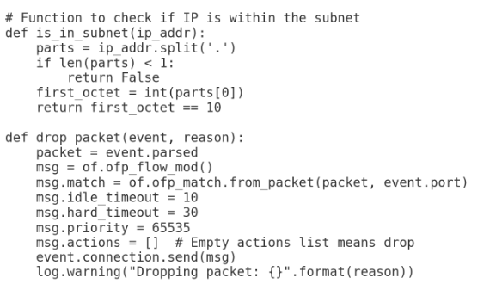
MITIGATION
SCRIPT OVERVIEW
subnet checking function
packet dropping function

Slide 44
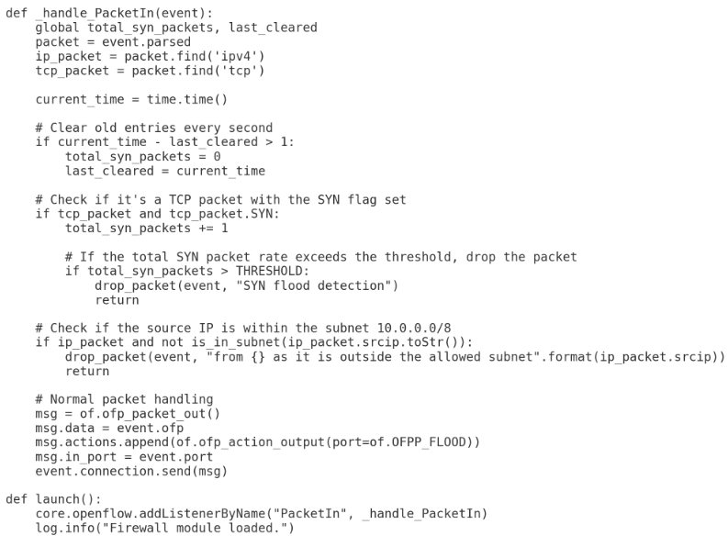
MITIGATION
SCRIPT OVERVIEW
rate limiter function
Launch Function

Slide 45
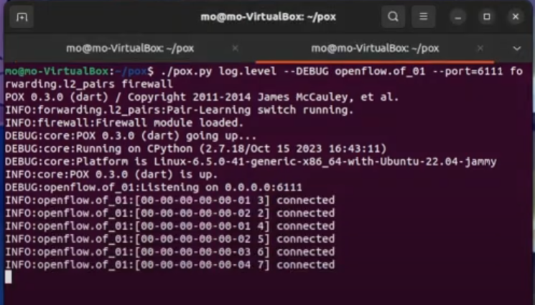
MITIGATION
LAUNCHING SYSTEM
running mitigation script in controllers .
doing the same with the other controller, but with changing port .

Slide 46
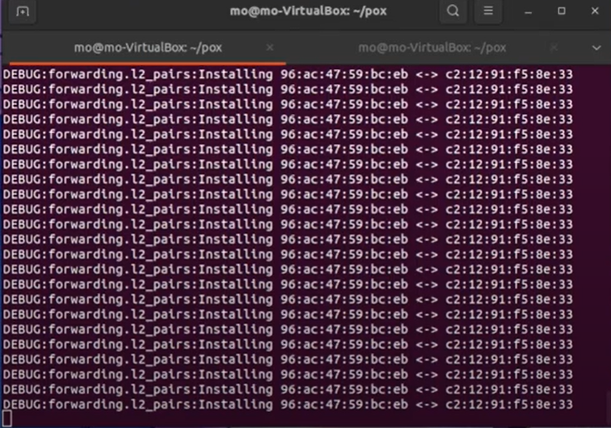
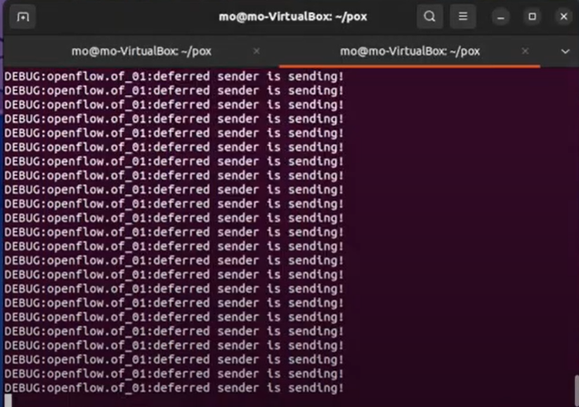
MITIGATION
DETECTION
controller outputs

Slide 47
MITIGATION
DETECTION
Detection using flow tables
focus on the added last section , actions .

Slide 48

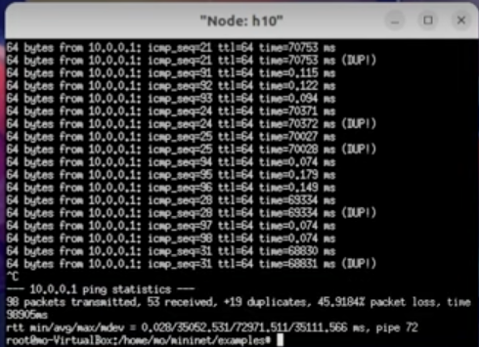
MITIGATION
DETECTION
Detection using ping
testing reachability immediately after applying mitigation script .

Slide 49
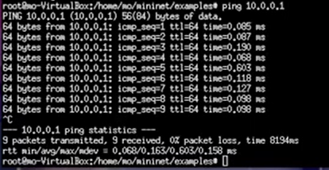
MITIGATION
DETECTION
Detection using ping
testing reachability after few seconds .
0% packet loss and high data rates as required .

Slide 50

FUTURE WORK
FUTURE WORK
- MACHINE LEARNING-BASED ANOMALY DETECTION
- GEO-FENCING AND TRAFFIC FILTERING BASED ON LOCATION

